Slide 1
MSRB Inventory Operations
File created on: 4/15/2026 12:21:40 PM

Slide 2


Slide 3
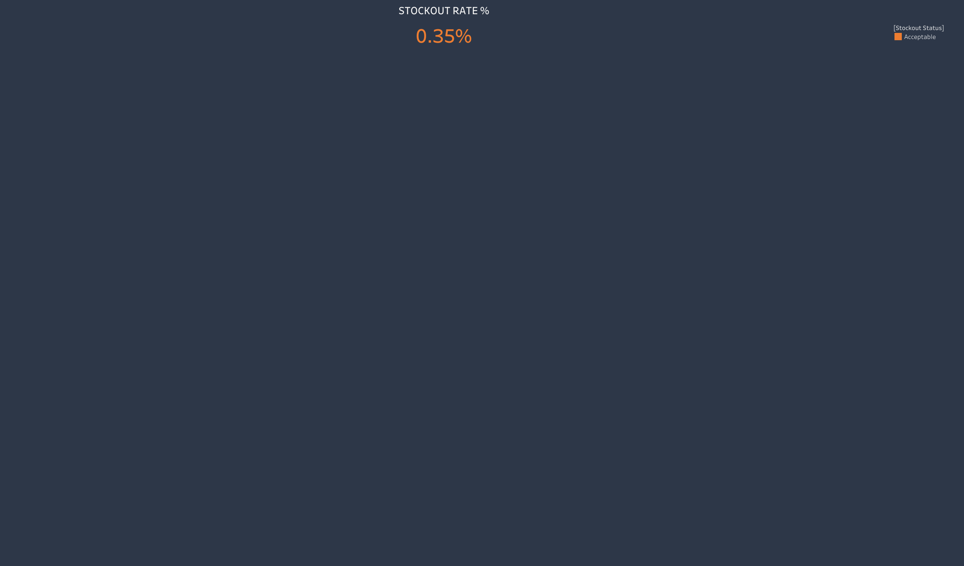

Slide 4
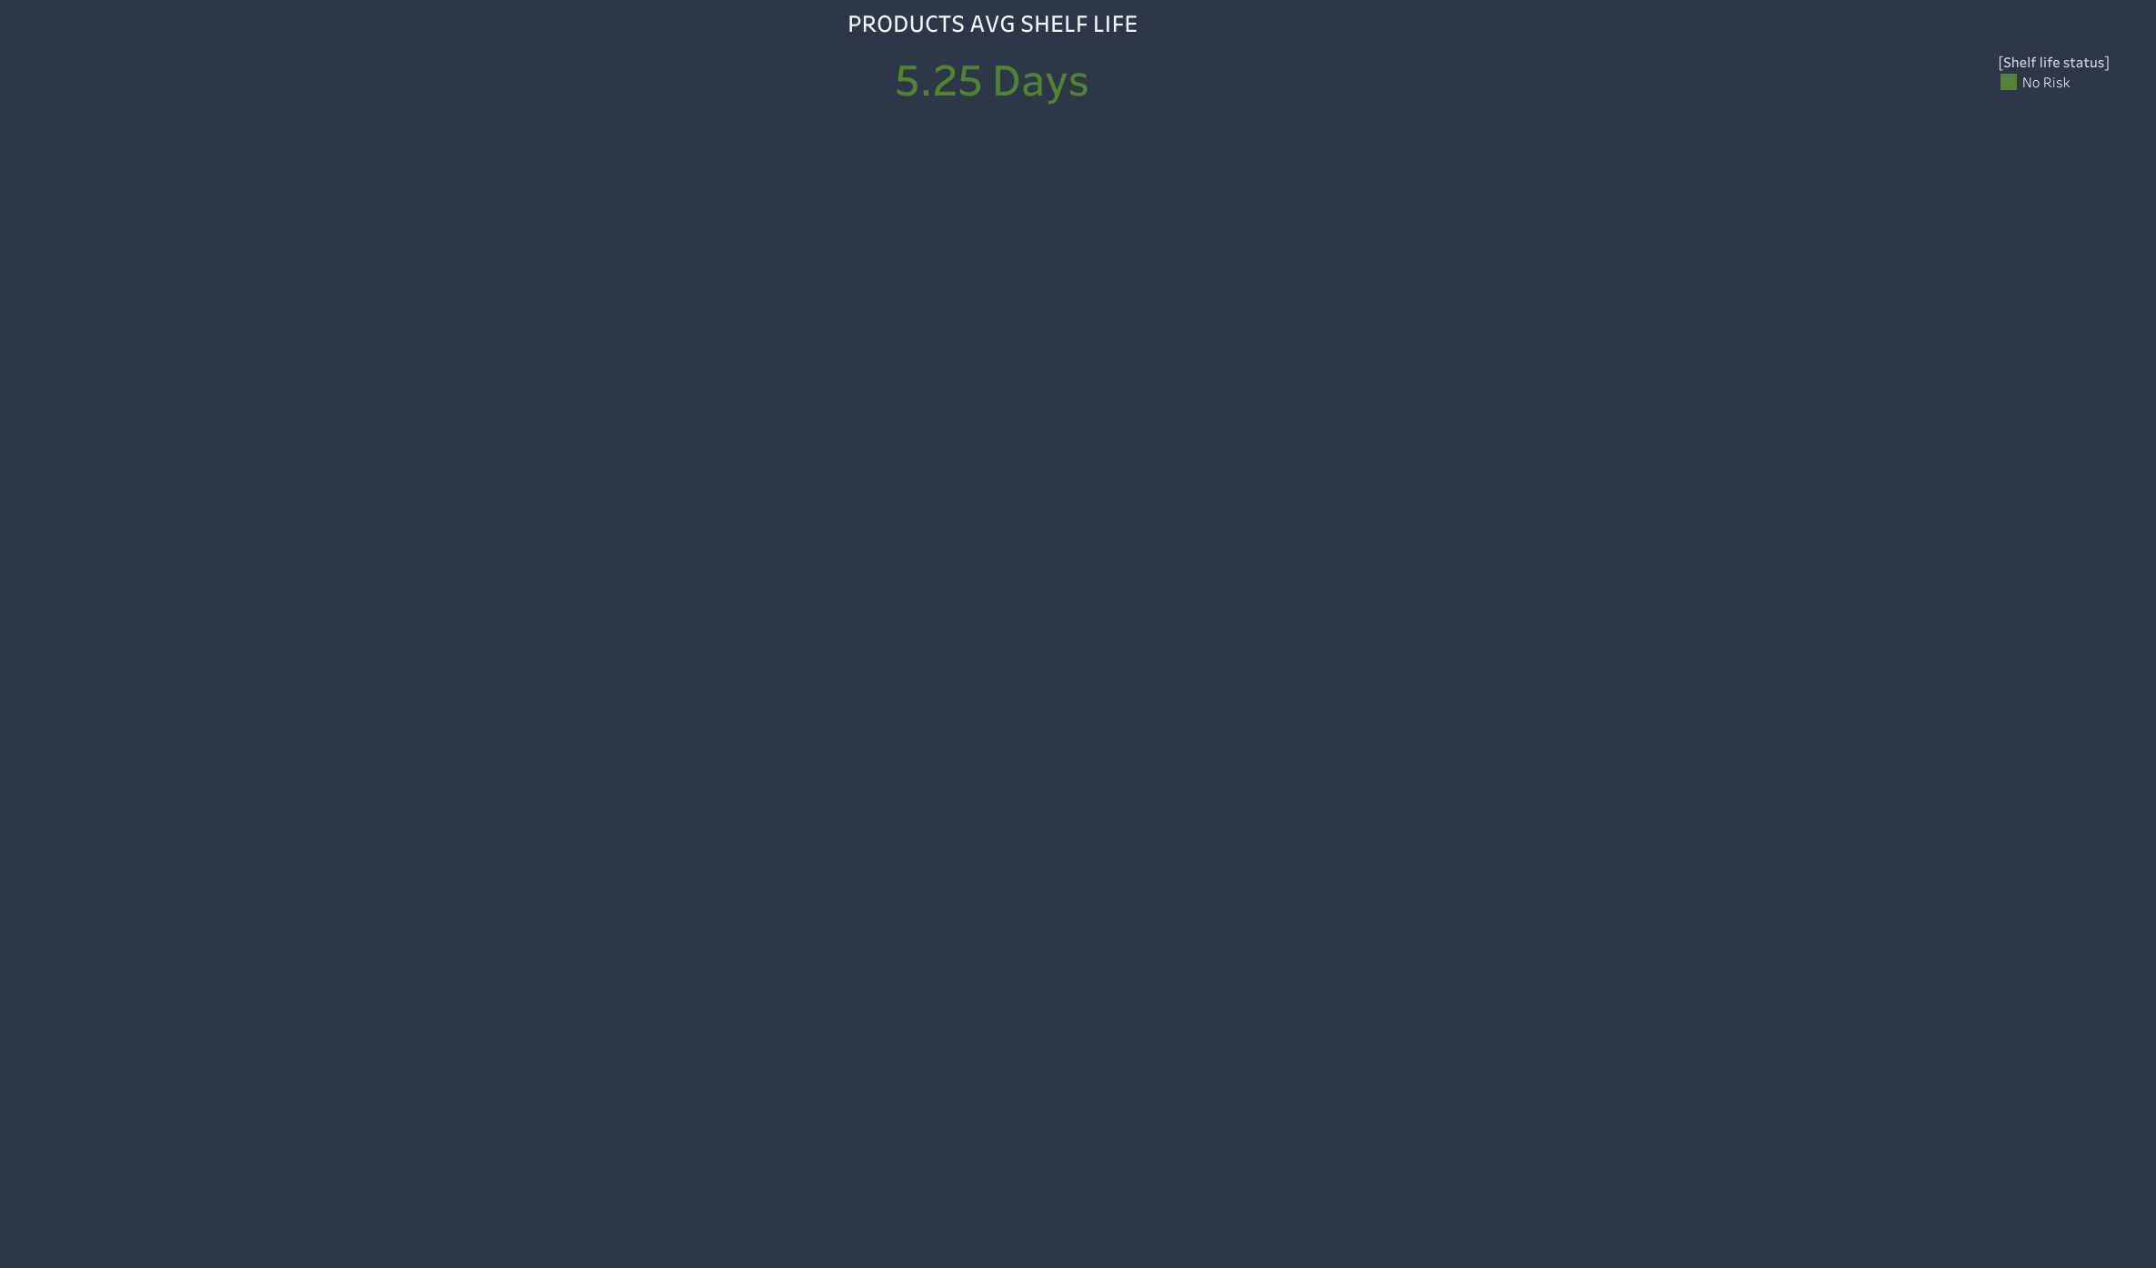

Slide 5


Slide 6
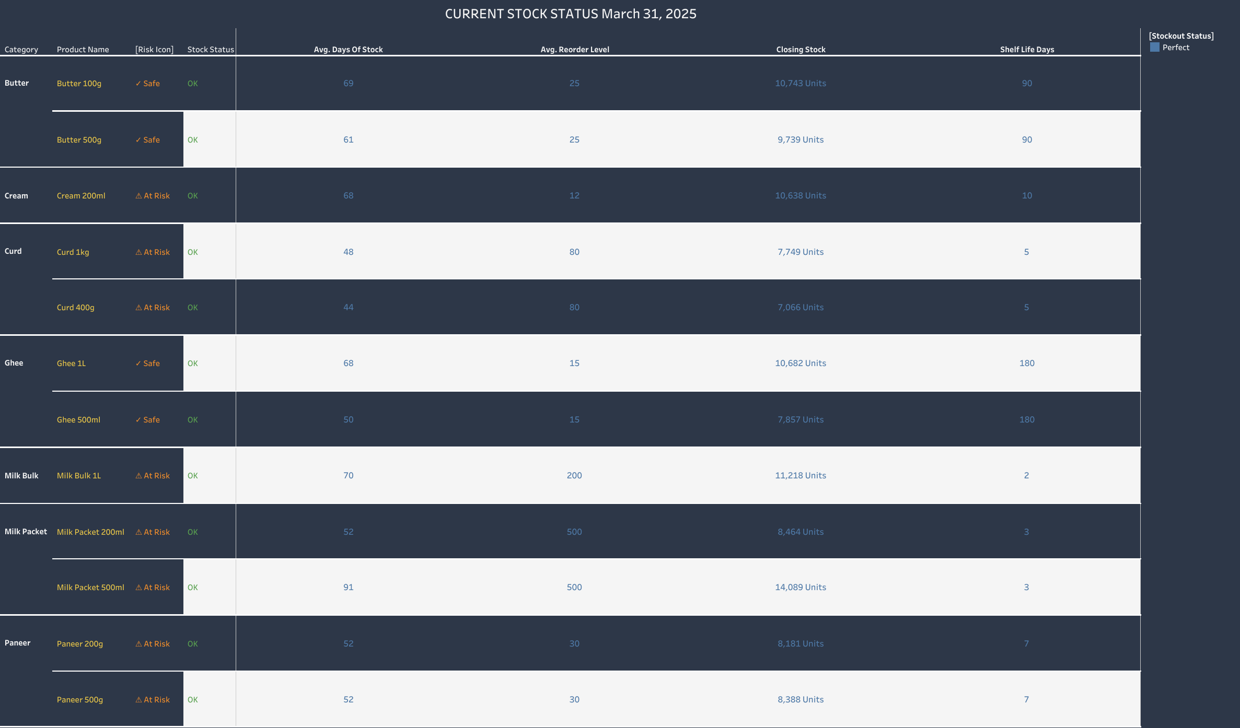

Slide 7
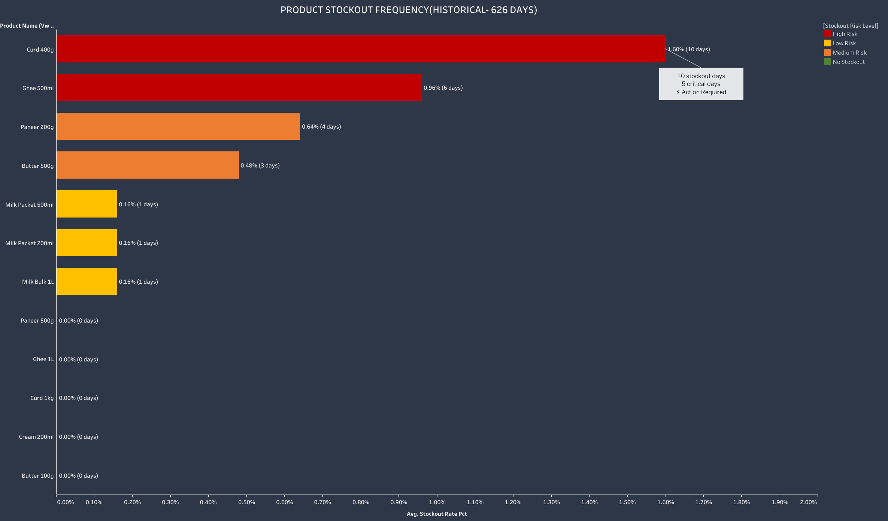

Slide 8
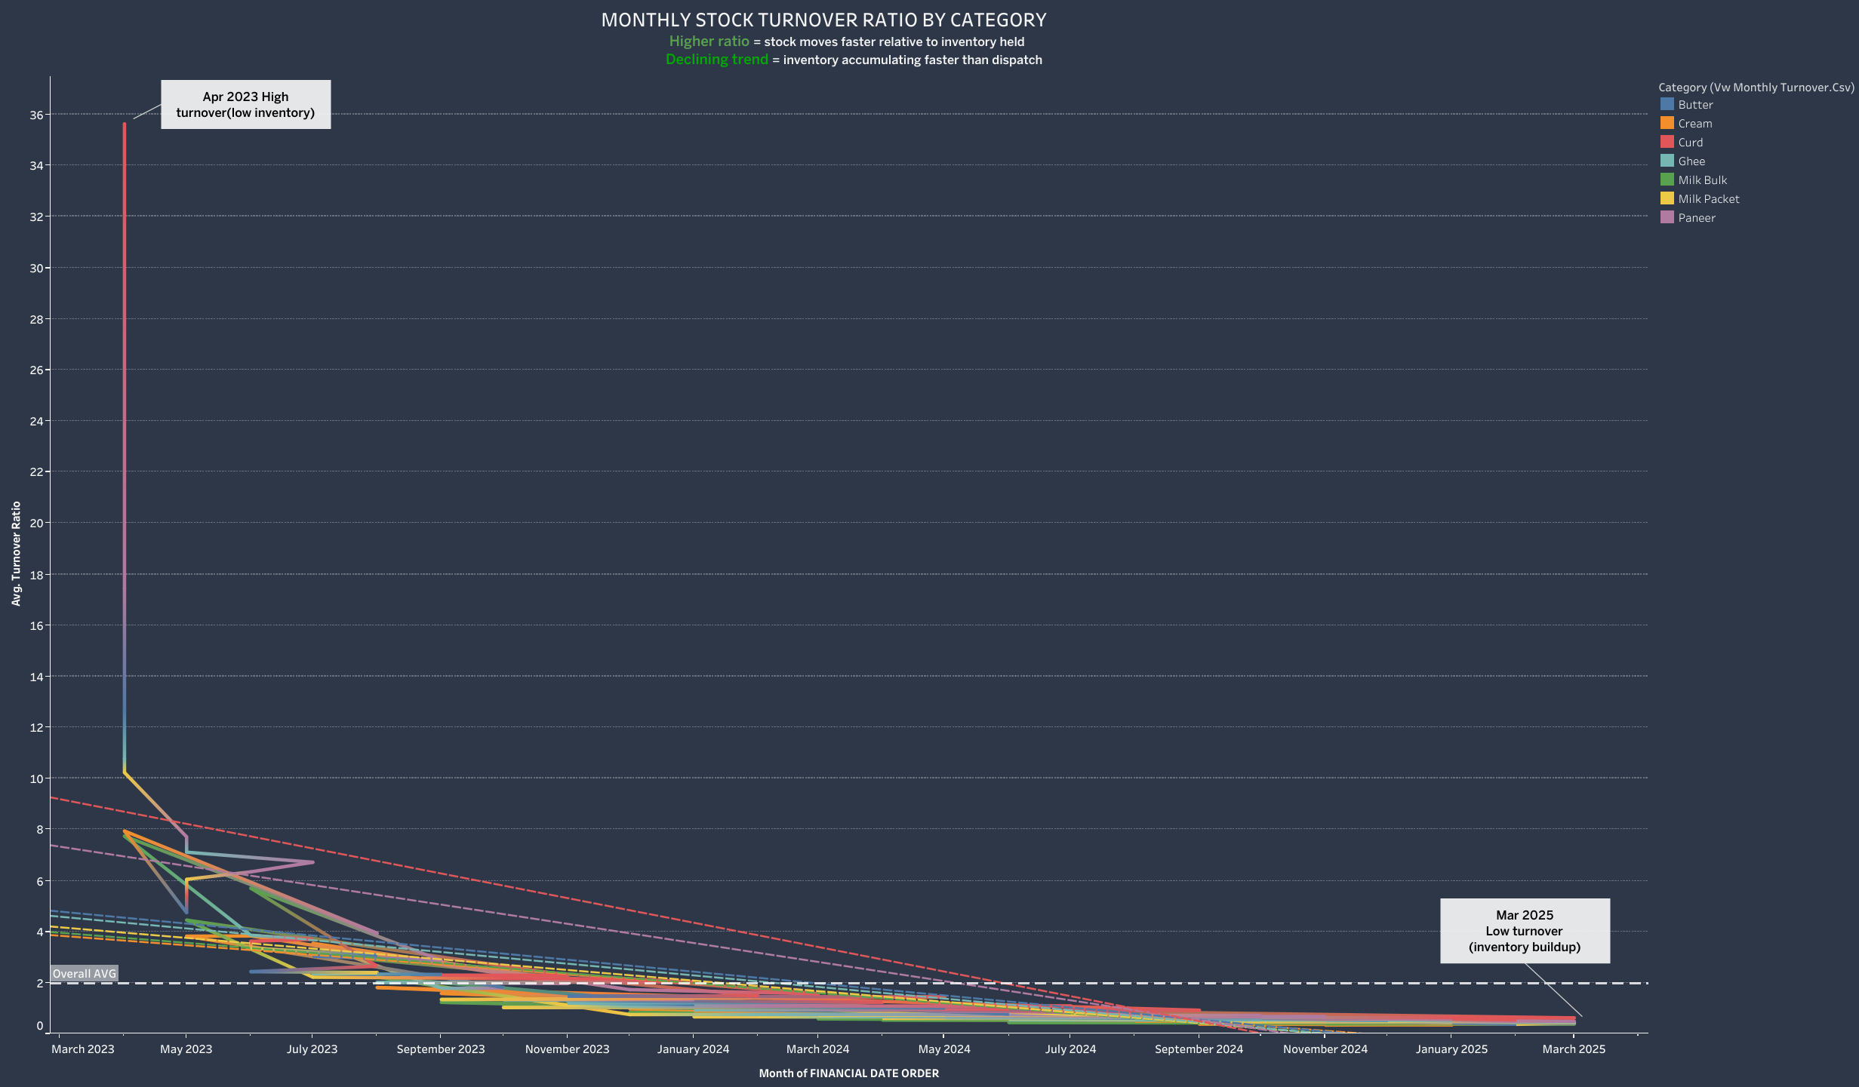

Slide 9
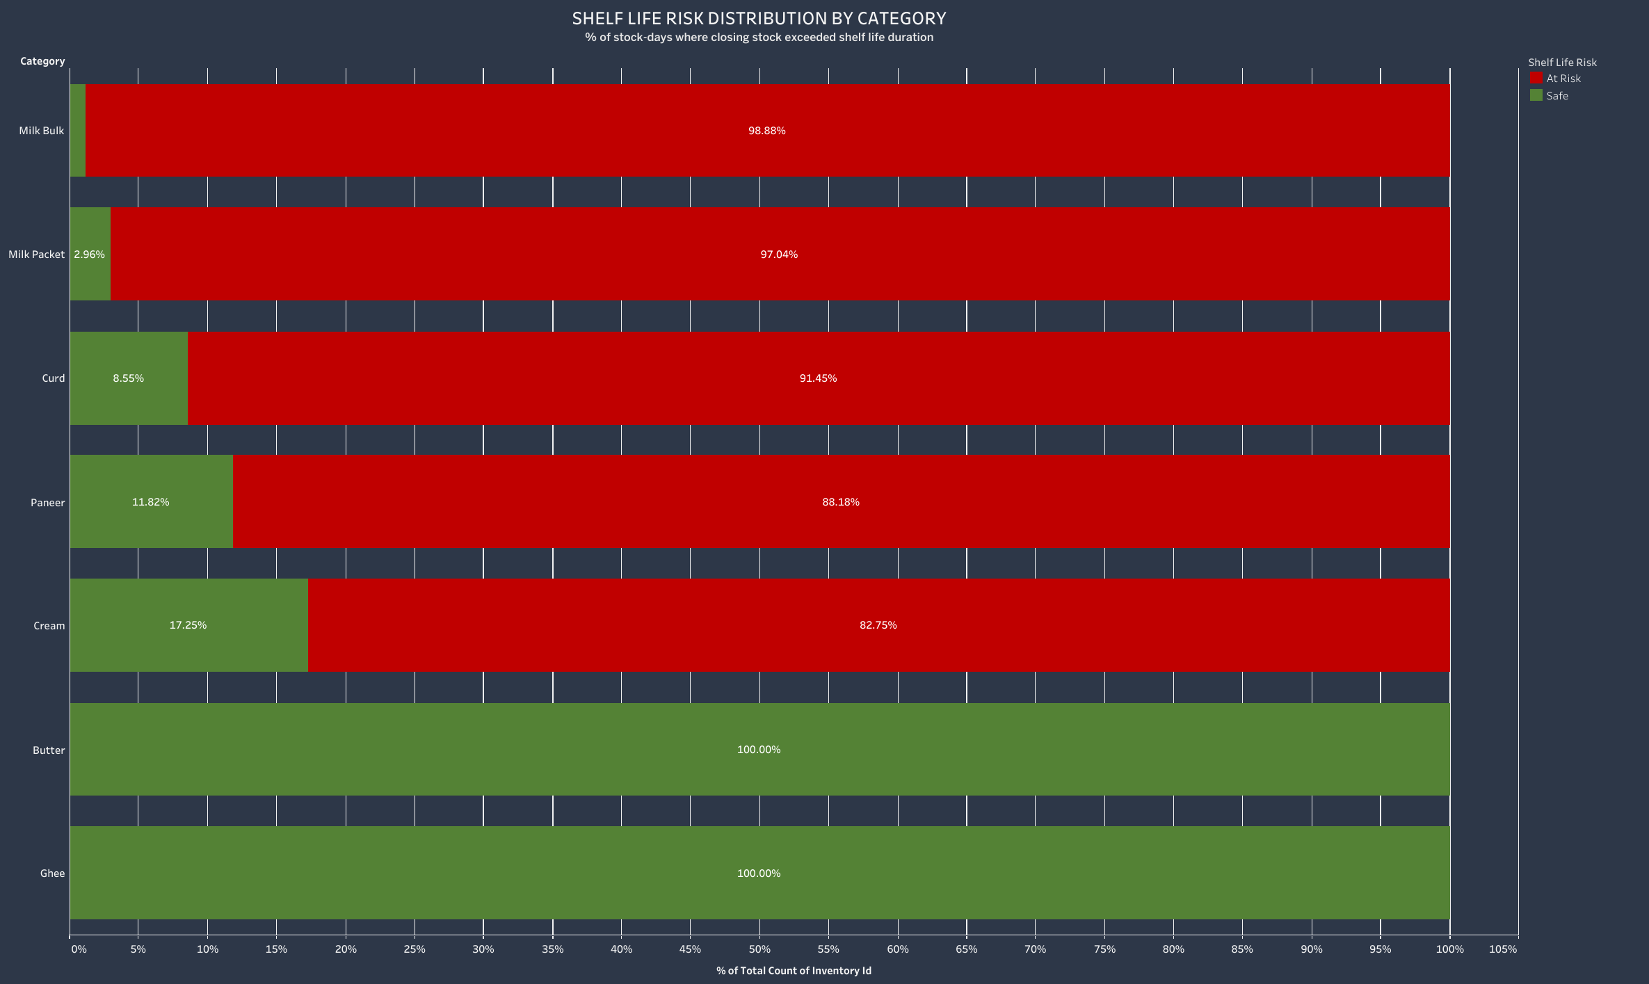

Slide 10
